Slide 2


Signals and Systems
Introduction

Slide 3



Signals
A signal is a function of one or more variables that conveys information about some (usually physical) phenomenon.
For a function f , in the expression f (t₁, t₂, . . . , t_{n}), each of the {t_{k}} is called an independent variable, while the function value itself is referred to as a dependent variable.
Some examples of signals include:
a voltage or current in an electronic circuit
the position, velocity, or acceleration of an object a force or torque in a mechanical system
a flow rate of a liquid or gas in a chemical process a digital image, digital video, or digital audio
a stock market index

Slide 4





Classification of Signals
Number of independent variables (i.e., dimensionality):
A signal with one independent variable is said to be one dimensional (e.g., audio).
A signal with more than one independent variable is said to be
multi-dimensional (e.g., image).
Continuous or discrete independent variables:
A signal with continuous independent variables is said to be continuous time (CT) (e.g., voltage waveform).
A signal with discrete independent variables is said to be discrete time (DT) (e.g., stock market index).
Continuous or discrete dependent variable:
A signal with a continuous dependent variable is said to be continuous valued (e.g., voltage waveform).
A signal with a discrete dependent variable is said to be discrete valued
(e.g., digital image).
A continuous-valued CT signal is said to be analog (e.g., voltage waveform).
A discrete-valued DT signal is said to be digital (e.g., digital audio).

Slide 5
Graphical Representation of Signals
x(t)
x(n)
3
3
2
2
1
1
t
n
−30 −20 −10 0 10 20 30
Continuous-Time (CT) Signal
−3 −2 −1 0 1 2 3
Discrete-Time (DT) Signal

Slide 6

Systems
A system is an entity that processes one or more input signals in order to produce one or more output signals.
x₀ x₁ x₂
y₀ y₁ y₂
System
.
x_{M}
`˛¸x
.
.
y_{N}
`˛¸x
.
.
.
.
.
Input Signals
Output Signals

Slide 7



Classification of Systems
Number of inputs:
A system with one input is said to be single input (SI).
A system with more than one input is said to be multiple input (MI).
Number of outputs:
A system with one output is said to be single output (SO).
A system with more than one output is said to be multiple output (MO).
Types of signals processed:
A system can be classified in terms of the types of signals that it processes. Consequently, terms such as the following (which describe signals) can also be used to describe systems:
one-dimensional and multi-dimensional, continuous-time (CT) and discrete-time (DT), and analog and digital.
For example, a continuous-time (CT) system processes CT signals and a discrete-time (DT) system processes DT signals.

Slide 8
Signal Processing Systems
x(t)
Continuous-to- Discrete-Time (C/D) Converter
p(n)
Discrete-Time System
q(n)
Discrete-to- Continuous-Time (D/C) Converter
y(t)
Processing a Continuous-Time Signal With a Discrete-Time System
x(n)
Discrete-to- Continuous-Time (D/C) Converter
p(t)
Continuous-Time System
q(t)
Continuous-to- Discrete-Time (C/D) Converter
y(n)
Processing a Discrete-Time Signal With a Continuous-Time System

Slide 9
Communication Systems
Estimate of Message Signal
Message Signal
Transmitted
Received Signal
Signal
Transmitter
Channel
Receiver
General Structure of a Communication System

Slide 10
Control Systems
Reference Input
Error
Controller
Plant
Output
+
−
Sensor
Feedback
Signal
General Structure of a Feedback Control System

Slide 11





Why Study Signals and Systems?
Engineers build systems that process/manipulate signals.
We need a formal mathematical framework for the study of such systems.
Such a framework is necessary in order to ensure that a system will meet the required specifications (e.g., performance and safety).
If a system fails to meet the required specifications or fails to work altogether, negative consequences usually ensue.
When a system fails to operate as expected, the consequences can sometimes be catastrophic.

Slide 12









System Failure Example: Tacoma Narrows Bridge
The (original) Tacoma Narrows Bridge was a suspension bridge linking Tacoma and Gig Harbor (WA, USA).
This mile-long bridge, with a 2,800-foot main span, was the third largest suspension bridge at the time of opening.
Construction began in Nov. 1938 and took about 19 months to build at a cost of $6,400,000.
On July 1, 1940, the bridge opened to traffic.
On Nov. 7, 1940 at approximately 11:00, the bridge collapsed during a moderate (42 miles/hour) wind storm.
The bridge was supposed to withstand winds of up to 120 miles/hour.
The collapse was due to wind-induced vibrations and an unstable mechanical system.
Repair of the bridge was not possible.
Fortunately, a dog trapped in an abandoned car was the only fatality.

Slide 13


Section 1.1
Signals

Slide 14





Signals
Earlier, we were introduced to CT and DT signals. A CT signal is called a function.
A DT signal is called a sequence.
Although, strictly speaking, a sequence is a special case of a function (where the domain of the function is the integers), we will use the term function exclusively to mean a function that is not a sequence.
The nth element of a sequence x is denoted as either x(n) or x_{n}.

Slide 15


Notation: Functions Versus Function Values
Strictly speaking, an expression like “ f (t)” means the value of the function f
evaluated at the point t.
Unfortunately, engineers often use an expression like “ f (t)” to refer to the function f (rather than the value of f evaluated at the point t), and this sloppy notation can lead to problems (e.g., ambiguity) in some situations.
In contexts where sloppy notation may lead to problems, one should be careful to clearly distinguish between a function and its value.
Example (meaning of notation):
Let f and g denote real-valued functions of a real variable. Let t denote an arbitrary real number.
Let H denote a system operator (which maps a function to a function). The quantity f + g is a function, namely, the function formed by adding the functions f and g.
The quantity f (t) + g(t) is a number, namely, the sum of: the value of the
function f evaluated at t; and the value of the function g evaluated at t. The quantity H x is a function, namely, the output produced by the system represented by H when the input to the system is the function x.
The quantity H x(t) is a number, namely, the value of the function H x
evaluated at t.

Slide 16
Section 1.2
Properties of Signals

Slide 17




Even Signals
A function x is said to be even if it satisfies
x(t) = x(−t) for all t.
A sequence x is said to be even if it satisfies
x(n) = x(−n) for all n.
Geometrically, the graph of an even signal is symmetric about the origin. Some examples of even signals are shown below.
x(t)
x(n)
2
2
1
1
−3 −2 −1
1
2
3
t
n
−3 −2 −1
1
2
3
−1
−2
−1
−2

Slide 18





Odd Signals
A function x is said to be odd if it satisfies
x(t) = −x(−t) for all t.
A sequence x is said to be odd if it satisfies
x(n) = −x(−n) for all n.
Geometrically, the graph of an odd signal is antisymmetric about the origin.
An odd signal x must be such that x(0) = 0. Some examples of odd signals are shown below.
x(t)
x(n)
2
2
1
1
−3 −2 −1
1
2
3
t
n
−3 −2 −1
1
2
3
−1
−2
−1
−2

Slide 19





Periodic Signals
A function x is said to be periodic with period T (or T -periodic) if, for some strictly-positive real constant T , the following condition holds:
x(t) = x(t + T ) for all t.
A T -periodic function x is said to have frequency
1
T
and angular
frequency ^{2π} .
T
A sequence x is said to be periodic with period N (or N-periodic) if, for some strictly-positive integer constant N, the following condition holds:
x(n) = x(n + N) for all n.
An N-periodic sequence x is said to have frequency ¹ and angular
N
frequency ^{2π} .
N
A function/sequence that is not periodic is said to be aperiodic.

Slide 20

Periodic Signals (Continued 1)
Some examples of periodic signals are shown below.
x(t)
. . .
. . .
−2T
−T
T
2T
t
x(n)
4
3
· · ·
2
· · ·
1
−4 −3 −2 −1 0
1
2
3
4
5
6
7
n

Slide 21

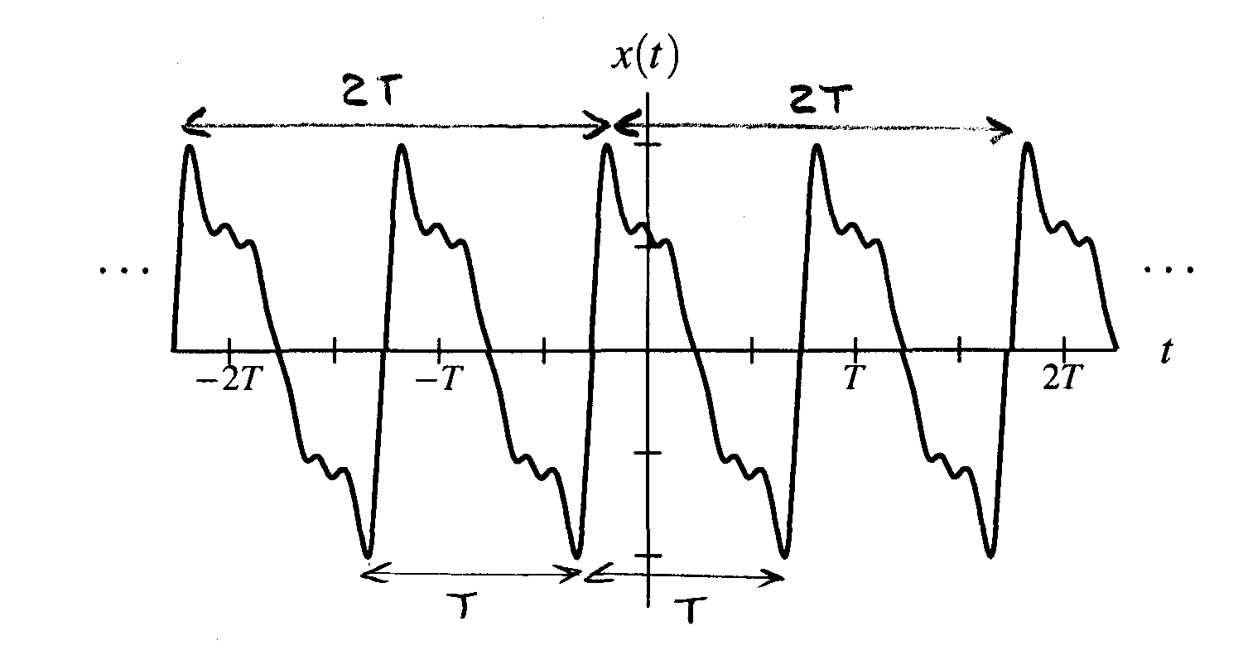

Periodic Signals (Continued 2)
The period of a periodic signal is not unique. That is, a signal that is periodic with period T is also periodic with period kT , for every (strictly) positive integer k.
The smallest period with which a signal is periodic is called the fundamental period and its corresponding frequency is called the fundamental frequency.

Slide 22
Part 2
Continuous-Time (CT) Signals and Systems

Slide 23


Section 2.1
Independent- and Dependent-Variable Transformations

Slide 24




Time Shifting (Translation)
Time shifting (also called translation) maps the input signal x to the output signal y as given by
y(t) = x(t − b),
where b is a real number.
Such a transformation shifts the signal (to the left or right) along the time axis.
If b > 0, y is shifted to the right by |b|, relative to x (i.e., delayed in time). If b < 0, y is shifted to the left by |b|, relative to x (i.e., advanced in time).

Slide 25
Time Shifting (Translation): Example
x(t)
3
2
1
t
−3 −2 −1 0
1
2
3
x(t − 1)
x(t + 1)
3
3
2
2
1
1
t
t
−3 −2 −1 0
1
2
3
−3 −2 −1 0
1
2
3

Slide 26


Time Reversal (Reflection)
Time reversal (also known as reflection) maps the input signal x to the output signal y as given by
y(t) = x(−t).
Geometrically, the output signal y is a reflection of the input signal x about the (vertical) line t = 0.
x(t) x(−t)
3
3
2
2
1
1
t
t
−3 −2 −1 0
1
2
3
−3 −2 −1 0
1
2
3

Slide 27




Time Compression/Expansion (Dilation)
Time compression/expansion (also called dilation) maps the input signal x to the output signal y as given by
y(t) = x(at),
where a is a strictly positive real number.
Such a transformation is associated with a compression/expansion along the time axis.
If a > 1, y is compressed along the horizontal axis by a factor of a, relative to x.
If a < 1, y is expanded (i.e., stretched) along the horizontal axis by a
factor of ¹ , relative to x.
a

Slide 28
Time Compression/Expansion (Dilation): Example
x(t)
1
−2
−1
0
1
2
t
x(2t)
x(t/2)
1
1
−2
−1
0
1
2
t
−2
−1
0
1
2
t

Slide 29







Time Scaling
Time scaling maps the input signal x to the output signal y as given by
y(t) = x(at),
where a is a nonzero real number.
Such a transformation is associated with a dilation (i.e., compression/expansion along the time axis) and/or time reversal.
If |a| > 1, the signal is compressed along the time axis by a factor of |a|. If |a| < 1., th.e signal is expanded (i.e., stretched) along the time axis by a
factor of ^{. 1 .}.
a
If |a| = 1, the signal is neither expanded nor compressed.
If a < 0, the signal is also time reversed.
Dilation (i.e., expansion/compression) and time reversal commute.
Time reversal is a special case of time scaling with a = −1; and time compression/expansion is a special case of time scaling with a > 0.

Slide 30
Time Scaling (Dilation/Reflection): Example
x(t)
x(2t)
1
1
−2
−1
0
1
2
t
−2
−1
0
1
2
t
x(t/2)
x(−t)
1
1
−2
−1
0
1
2
t
−2
−1
0
1
2
t

Slide 31









Combined Time Scaling and Time Shifting
Consider a transformation that maps the input signal x to the output signal
y as given by
y(t) = x(at − b),
where a and b are real numbers and a /= 0.
The above transformation can be shown to be the combination of a time-scaling operation and time-shifting operation.
Since time scaling and time shifting do not commute, we must be particularly careful about the order in which these transformations are applied.
The above transformation has two distinct but equivalent interpretations:
1
first, time shifting x by b, and then time scaling the result by a; first, time scaling x by a, and then time shifting the result by b/a.
2
Note that the time shift is not by the same amount in both cases.

Slide 32
Combined Time Scaling and Time Shifting: Example
time shift by 1 and then time scale by 2
p(t) = x(t − 1) p(2t) = x(2t − 1)
1 1
1
1
2
t
— ₂
t
Given x(t) as shown below, find x(2t − 1).
x(t)
−1
1
2
3
−2 −1
1
3
2
2
−1
−1
1
t
time scale by 2 and then time shift by ¹
−2 −1
1
2
2
−1
q(t − 1/2) = x(2(t − 1/2)
q(t) = x(2t)
= x(2t − 1)
1
1
t
1
1
2
— ₂
t
−2 −1
1
2
−2 −1
1
3
2
2
−1
−1

Slide 33









Two Perspectives on Independent-Variable Transformations
A transformation of the independent variable can be viewed in terms of
1
the effect that the transformation has on the signal; or
the effect that the transformation has on the horizontal axis.
2
This distinction is important because such a transformation has opposite
effects on the signal and horizontal axis.
For example, the (time-shifting) transformation that replaces t by t − b
(where b is a real number) in x(t) can be viewed as a transformation that
1
shifts the signal x right by b units; or shifts the horizontal axis left by b units.
2
In our treatment of independent-variable transformations, we are only interested in the effect that a transformation has on the signal.
If one is not careful to consider that we are interested in the signal perspective (as opposed to the axis perspective), many aspects of independent-variable transformations will not make sense.

Slide 34


Amplitude Scaling
Amplitude scaling maps the input signal x to the output signal y as given by
y(t) = ax(t),
where a is a real number.
Geometrically, the output signal y is expanded/compressed in amplitude and/or reflected about the horizontal axis.
x(t) 2x(t)
2 2
1 1
−3 −2 −1
−1
−2
t
t
1 2 3 −3 −2 −1
−1
−2
1 2 3
¹ x(t)
−2x(t)
2
2
2
1
1
−3 −2 −1
−1
−2
1 2 3
t
−3 −2 −1
−1
−2
1 2 3
t

Slide 35


Amplitude Shifting
Amplitude shifting maps the input signal x to the output signal y as given by
y(t) = x(t) + b,
where b is a real number.
Geometrically, amplitude shifting adds a vertical displacement to x.
x(t)
x(t) − 2
2
2
1
1
t
t
−3 −2 −1
1
2
3
−3 −2 −1
1
2
3
−1
−2
−1
−2

Slide 36








Combined Amplitude Scaling and Amplitude Shifting
We can also combine amplitude scaling and amplitude shifting transformations.
Consider a transformation that maps the input signal x to the output signal
y, as given by
y(t) = ax(t) + b,
where a and b are real numbers.
Equivalently, the above transformation can be expressed as
_{b}
y(t) = a x(t) + _{a} .
The above transformation is equivalent to:
1
first amplitude scaling x by a, and then amplitude shifting the resulting signal by b; or
first amplitude shifting x by b/a, and then amplitude scaling the resulting signal by a.
2

Slide 37
Properties of Signals

Slide 38




Symmetry and Addition/Multiplication
Sums involving even and odd functions have the following properties:
The sum of two even functions is even. The sum of two odd functions is odd.
The sum of an even function and odd function is neither even nor odd, provided that neither of the functions is identically zero.
That is, the sum of functions with the same type of symmetry also has the
same type of symmetry.
Products involving even and odd functions have the following properties:
The product of two even functions is even. The product of two odd functions is even.
The product of an even function and an odd function is odd.
That is, the product of functions with the same type of symmetry is even, while the product of functions with opposite types of symmetry is odd.

Slide 39




Decomposition of a Signal into Even and Odd Parts
Every function x has a unique representation of the form
x(t) = x_{e}(t) + x_{o}(t),
where the functions x_{e} and x_{o} are even and odd, respectively. In particular, the functions x_{e} and x_{o} are given by
1 1
x (t) = [x(t) + x(
−t)] and x (t) = [x(t) − x(
−t)] .
e
o
2 2
The functions x_{e} and x_{o} are called the even part and odd part of x, respectively.
For convenience, the even and odd parts of x are often denoted as
Even{x} and Odd{x}, respectively.

Slide 40

Sum of Periodic Functions
Sum of periodic functions. Let x₁ and x₂ be periodic functions with fundamental periods T₁ and T₂, respectively. Then, the sum y = x₁ + x₂ is a periodic function if and only if the ratio T₁/T₂ is a rational number (i.e.,
the quotient of two integers). Suppose that T₁/T₂ = q/r where q and r are integers and coprime (i.e., have no common factors), then the
fundamental period of y is rT₁ (or equivalently, qT₂, since rT₁ = qT₂). (Note that rT₁ is simply the least common multiple of T₁ and T₂.)
Although the above theorem only directly addresses the case of the sum of two functions, the case of N functions (where N > 2) can be handled by applying the theorem repeatedly N − 1 times.

Slide 41





Right-Sided Signals
A signal x is said to be right sided if, for some (finite) real constant t₀, the following condition holds:
x(t) = 0 for all t < t₀
(i.e., x is only potentially nonzero to the right of t₀). An example of a right-sided signal is shown below.
x(t)
· · ·
t
t₀
A signal x is said to be causal if
x(t) = 0 for all t < 0.
A causal signal is a special case of a right-sided signal.
A causal signal is not to be confused with a causal system. In these two contexts, the word “causal” has very different meanings.

Slide 42





Left-Sided Signals
A signal x is said to be left sided if, for some (finite) real constant t₀, the following condition holds:
x(t) = 0 for all t > t₀
(i.e., x is only potentially nonzero to the left of t₀). An example of a left-sided signal is shown below.
x(t)
· · ·
t
t₀
Similarly, a signal x is said to be anticausal if
x(t) = 0 for all t > 0.
An anticausal signal is a special case of a left-sided signal.
An anticausal signal is not to be confused with an anticausal system. In these two contexts, the word “anticausal” has very different mea nings.

Slide 43




Finite-Duration and Two-Sided Signals
A signal that is both left sided and right sided is said to be finite duration
(or time limited).
An example of a finite duration signal is shown below.
x(t)
t
t₀ t₁
A signal that is neither left sided nor right sided is said to be two sided. An example of a two-sided signal is shown below.
x(t)
· · ·
· · ·
t

Slide 44



Bounded Signals
A signal x is said to be bounded if there exists some (finite) positive real constant A such that
|x(t)| ≤ A for all t
(i.e., x(t) is finite for all t).
Examples of bounded signals include the sine and cosine functions.
Examples of unbounded signals include the tan function and any nonconstant polynomial function.

Slide 45





Signal Energy and Power
Energy Signal
A signal is said to be an energy signal if and only if its total energy E is finite, i.e., 0 < 𝐸 < ∞. For an energy signal, the average power P = 0. The nonperiodic signals are the examples of energy signals.
The energy E contained in the signal x is given by
A signal with finite energy is said to be an energy signal. The average power P contained in the signal x is given by
A signal with (nonzero) finite average power is said to be a power signal.
Power Signal
A signal is said to be a power signal if its average power P is finite, i.e., 0 < 𝑃 < ∞. For a power signal, the total energy E = ∞. The periodic signals are the examples of power signals.

Slide 46
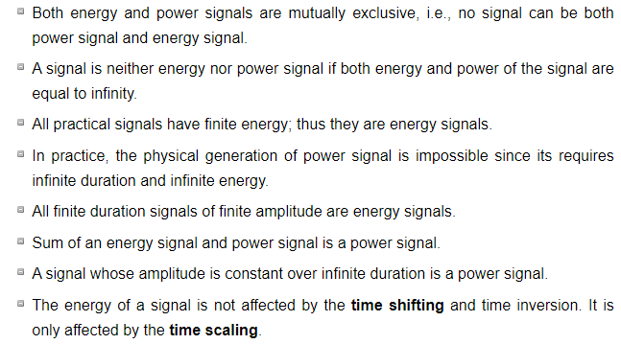
Properties of Energy and Power Signals

Slide 47
Elementary Signals

Slide 48


Real Sinusoids
A (CT) real sinusoid is a function of the form
x(t) = A cos(ωt + θ),
where A, ω, and θ are real constants.
Such a function is periodic with fundamental period T = ^{2π} and
|ω|
fundamental frequency |ω|.
A real sinusoid has a plot resembling that shown below.
A cos(ωt + θ)
A cosθ
t

Slide 49

Complex Exponentials
A (CT) complex exponential is a function of the form
x(t) = Ae^{λt} ,
where A and λ are complex constants.
A complex exponential can exhibit one of a number of distinct modes of behavior, depending on the values of its parameters A and λ.
For example, as special cases, complex exponentials include real exponentials and complex sinusoids.

Slide 50





Real Exponentials
A real exponential is a special case of a complex exponential
x(t) = Ae^{λt} , where A and λ are restricted to be real numbers.
A real exponential can exhibit one of three distinct modes of behavior, depending on the value of λ, as illustrated below.
If λ > 0, x(t) increases exponentially as t increases (i.e., a growing exponential). If λ < 0, x(t) decreases exponentially as t increases (i.e., a decaying exponential). If λ = 0, x(t) simply equals the constant A.
_{Ae}λt
_{Ae}λt _{Ae}λt
A
A
A
t
t
t
λ > 0
λ = 0
λ < 0

Slide 51





Complex Sinusoids
A complex sinusoid is a special case of a complex exponential x(t) = Ae^{λt} , where A is complex and λ is purely imaginary (i.e., Re{λ} = 0).
That is, a (CT) complex sinusoid is a function of the form
x(t) = Ae^{jωt} ,
where A is complex and ω is real.
By expressing A in polar form as A = |A| e ^{jθ} (where θ is real) and using Euler’s relation, we can rewrite x(t) as
x(t) = |A|cos(ωt + θ) + j |A|sin(ωt + θ).
` ˛¸ x ` ˛¸ x
Re{x(t)} Im{x(t)}
Thus, Re{x} and Im{x} are the same except for a time shift.
Also, x is periodic with fundamental period T = ^{2π} and fundamental
|ω|
frequency |ω|.

Slide 52

Complex Sinusoids (Continued)
The graphs of Re{x} and Im{x} have the forms shown below.
|A|cos(ωt + θ) |A|sin(ωt + θ)
|A| |A|
|A|cosθ
t
t
|A|sinθ
−|A|
−|A|

Slide 53





General Complex Exponentials
In the most general case of a complex exponential x(t) = Ae^{λt} , A and λ
are both complex.
Letting A = |A| e ^{jθ} and λ = σ + jω (where θ, σ, and ω are real), and using Euler’s relation, we can rewrite x(t) as
σt σt
x(t) = |A| e cos(ωt + θ) + j |A| e sin(ωt + θ).
` ˛¸
x ` ˛¸ x
Re{x(t)} Im{x(t)}
Thus, Re{x} and Im{x} are each the product of a real exponential and
real sinusoid.
One of three distinct modes of behavior is exhibited by x(t), depending on the value of σ.
If σ = 0, Re{x} and Im{x} are real sinusoids.
If σ > 0, Re{x} and Im{x} are each the product of a real sinusoid and a growing real exponential.
If σ < 0, Re{x} and Im{x} are each the product of a real sinusoid and a decaying real exponential.

Slide 54

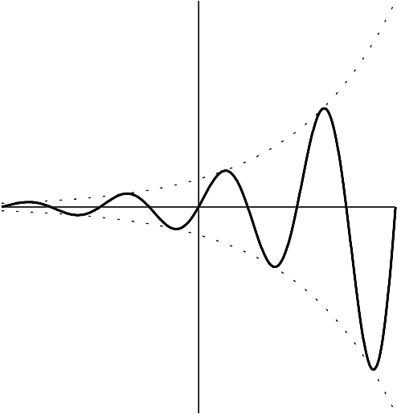
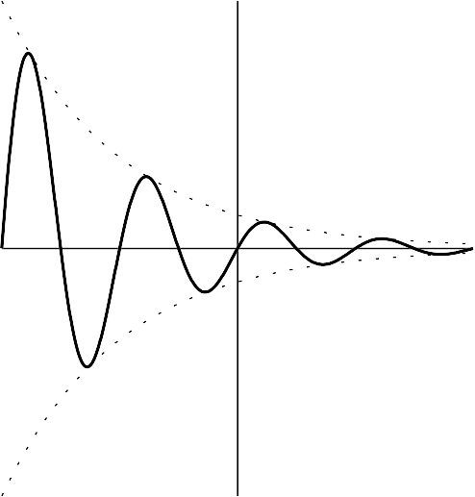

General Complex Exponentials (Continued)
The three modes of behavior for Re{x} and Im{x} are illustrated below.
|A| e
σt
|A| e
σt
|A| e
σt
t
t
t
σ > 0
σ = 0
σ < 0

Slide 55


Relationship Between Complex Exponentials and Real Sinusoids
From Euler’s relation, a complex sinusoid can be expressed as the sum of two real sinusoids as
Ae^{jωt} = A cosωt + jA sinωt.
Moreover, a real sinusoid can be expressed as the sum of two complex sinusoids using the identities
_{A} h
2
i
— j(ωt+θ)
A cos(ωt + θ) =
j(ωt+θ)
e + e
and
i
.
A
A sin(ωt + θ) =
h
_{e} j(ωt+θ) _{− e}− j(ωt+θ)
2 j
Note that, above, we are simply restating results material on complex analysis.

Slide 56



Unit-Step Function
The unit-step function (also known as the Heaviside function), denoted
u, is defined as
(
1 if t ≥ 0
0 otherwise.
u(t) =
Due to the manner in which u is used in practice, the actual value of u(0)
is unimportant. Sometimes values of 0 and ¹ are also used for u(0).
2
A plot of this function is shown below.
u(t)
1
· · ·
· · ·
t
−1
0
1

Slide 57



Signum Function
The signum function, denoted sgn, is defined as

From its definition, one can see that the signum function simply computes
the sign of a number.
A plot of this function is shown below.
sgn t
1
· · ·
t
−3 −2 −1
1
2
3
· · ·
−1

Slide 58


Rectangular Function
The rectangular function (also called the unit-rectangular pulse function), denoted rect, is given by
(
1 if − ≤ t <
0 otherwise.
1
2
1
rect(t) =
2
Due to the manner in which the rect function is used in practice, the actual
1
value of rect(t) at t = ± is unimportant. Sometimes different values are
2
used from those specified above.
A plot of this function is shown below.
rect(t)
1
t
1
1
2
— ₂ 0

Slide 59


Triangular Function
The triangular function (also called the unit-triangular pulse function), denoted tri, is defined as
(
1 − 2 |t| |t| ≤
1
tri(t) =
2
0 otherwise.
A plot of this function is shown below.
tri(t)
1
t
1
1
2
— ₂ 0

Slide 60


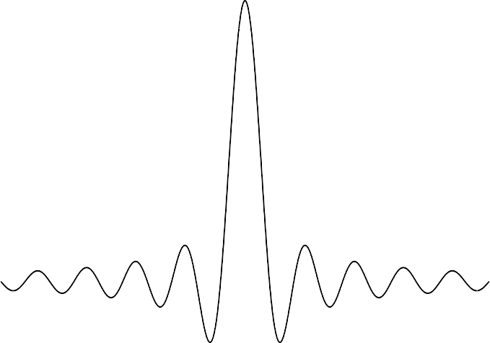
Cardinal Sine Function
The cardinal sine function, denoted sinc, is given by
sin t
sinc(t) =
.
t
By l’Hopital’s rule, sinc 0 = 1.
A plot of this function for part of the real line is shown below. [Note that the oscillations in sinc(t) do not die out for finite t.]
1
0.8
0.6
0.4
0.2
0
−0.2
−0.4
−10π −5π
0
5π
10π

Slide 61




Unit-Impulse Function
The unit-impulse function (also known as the Dirac delta function or
delta function), denoted δ, is defined by the following two properties:
δ(t) = 0 for t /= 0 and
∫ ∞
δ(t)dt = 1.
−∞
Technically, δ is not a function in the ordinary sense. Rather, it is what is known as a generalized function. Consequently, the δ function sometimes behaves in unusual ways.
Graphically, the delta function is represented as shown below.
δ(t)
Kδ(t − t₀)
1
K
t
0 t₀
t
0

Slide 62




Unit-Impulse Function as a Limit
Define
(
1/ε for |t| < ε/2
0 otherwise.
g (t) =
ε
The function g_{ε} has a plot of the form shown below.
g_{ε}(t)
1 ε
−
ε
2
0
ε
2
t
¸ ∞
Clearly, for any choice of ε,
g (t)dt = 1.
−∞
ε
The function δ can be obtained as the following limit:
δ(t) = lim g_{ε}(t).
ε→0
That is, δ can be viewed as a limiting case of a rectangular pulse where the pulse width becomes infinitesimally small and the pulse height becomes infinitely large in such a way that the integral of the resulting function remains unity.

Slide 63



Properties of the Unit-Impulse Function
Equivalence property. For any continuous function x and any real constant t₀,
x(t)δ(t − t₀) = x(t₀)δ(t − t₀).
Sifting property. For any continuous function x and any real constant t₀,
∫ ∞
x(t)δ(t − t₀)dt = x(t₀).
−∞
The δ function also has the following properties:
δ(t) = δ(−t) and
δ(at) = ¹ δ(t),
|a|
where a is a nonzero real constant.

Slide 64




Representing a Rectangular Pulse Using Unit-Step Functions
For real constants a and b where a ≤ b, consider a function x of the form
(
1 if a ≤ t < b
0 otherwise
x(t) =
(i.e., x(t) is a rectangular pulse of height one, with a rising edge at a and
falling edge at b).
The function x can be equivalently written as
x(t) = u(t − a) − u(t − b)
(i.e., the difference of two time-shifted unit-step functions).
Unlike the original expression for x, this latter expression for x does not involve multiple cases.
In effect, by using unit-step functions, we have collapsed a formula involving multiple cases into a single expression.

Slide 65



Representing Functions Using Unit-Step Functions
The idea from the previous slide can be extended to handle any function that is defined in a piecewise manner (i.e., via an expression involving multiple cases).
That is, by using unit-step functions, we can always collapse a formula involving multiple cases into a single expression.
Often, simplifying a formula in this way can be quite beneficial.

Slide 66
Section 2.4
Continuous-Time (CT) Systems

Slide 67



CT Systems
A system with input x and output y can be described by the equation
y = H {x},
where H denotes an operator (i.e., transformation).
Note that the operator H maps a function to a function (not a number to a number).
Alternatively, we can express the above relationship using the notation
x −→ y.
If clear from the context, the operator H is often omitted, yielding the abbreviated notation
H
x → y.
Note that the symbols “→” and “=” have very different meanings. The symbol “→” should be read as “produces” (not as “equals”).

Slide 68

Block Diagram Representations
Often, a system defined by the operator H and having the input x and output y is represented in the form of a block diagram as shown below.
Input
x(t)
Output
y(t)
System
H

Slide 69




Interconnection of Systems
Two basic ways in which systems can be interconnected are shown below.
x(t) y(t)
System 1
H₁
+
x(t)
System 1
H₁
System 2
H₂
y(t)
System 2
H₂
Series
Parallel
A series (or cascade) connection ties the output of one system to the input of the other.
The overall series-connected system is described by the equation
}
y = H₂ H₁{x} .
A parallel connection ties the inputs of both systems together and sums their outputs.
The overall parallel-connected system is described by the equation
y = H₁{x} + H₂{x}.

Slide 70
Section 2.5
Properties of (CT) Systems

Slide 71




Memory and Causality
A system with input x and output y is said to have memory if, for any real
t₀, y(t₀) depends on x(t) for some t /= t₀.
A system that does not have memory is said to be memoryless. Although simple, a memoryless system is not very flexible, since its current output value cannot rely on past or future values of the input.
A system with input x and output y is said to be causal if, for every real t₀, y(t₀) does not depend on x(t) for some t > t₀.
If the independent variable t represents time, a system must be causal in order to be physically realizable.
Noncausal systems can sometimes be useful in practice, however, since the independent variable need not always represent time. For example, in some situations, the independent variable might represent position.

Slide 72






Invertibility
The inverse of a system H is another system H ⁻¹ such that the combined effect of H cascaded with H ⁻¹ is a system where the input and output are equal.
A system is said to be invertible if it has a corresponding inverse system (i.e., its inverse exists).
Equivalently, a system is invertible if its input x can always be uniquely
determined from its output y.
Note that the invertibility of a system (which involves mappings between functions) and the invertibility of a function (which involves mappings between numbers) are fundamentally different things.
An invertible system will always produce distinct outputs from any two
distinct inputs.
To show that a system is invertible, we simply find the inverse system. To show that a system is not invertible, we find two distinct inputs that result in identical outputs.
In practical terms, invertible systems are “nice” in the sense that their
effects can be undone.

Slide 73




Bounded-Input Bounded-Output (BIBO) Stability
A system with input x and output y is BIBO stable if, for every bounded x, y is bounded (i.e., |x(t)| < ∞ for all t implies that |y(t)| < ∞ for all t).
To show that a system is BIBO stable, we must show that every bounded input leads to a bounded output.
To show that a system is not BIBO stable, we only need to find a single
bounded input that leads to an unbounded output.
In practical terms, a BIBO stable system is well behaved in the sense that, as long as the system input remains finite for all time, the output will also remain finite for all time.
Usually, a system that is not BIBO stable will have serious safety issues. For example, an iPod with a battery input of 3.7 volts and headset output of ∞ volts would result in one vaporized Apple customer and one big lawsuit.

Slide 74





Time Invariance (TI)
A system H is said to be time invariant (TI) if, for every function x and every real number t₀, the following condition holds:
y(t − t₀) = H x′(t) where y = H x and x′(t) = x(t − t₀)
(i.e., H commutes with time shifts).
In other words, a system is time invariant if a time shift (i.e., advance or delay) in the input always results only in an identical time shift in the output.
A system that is not time invariant is said to be time varying.
In simple terms, a time invariant system is a system whose behavior does not change with respect to time.
Practically speaking, compared to time-varying systems, time-invariant systems are much easier to design and analyze, since their behavior does not change with respect to time.

Slide 75





Additivity, Homogeneity, and Linearity
A system H is said to be additive if, for all functions x₁ and x₂, the following condition holds:
H (x₁ + x₂) = H x₁ + H x₂
(i.e., H commutes with sums).
A system H is said to be homogeneous if, for every function x and every complex constant a, the following condition holds:
H (ax) = aH x
(i.e., H commutes with multiplication by a constant).
A system that is both additive and homogeneous is said to be linear.
In other words, a system H is linear, if for all functions x₁ and x₂ and all complex constants a₁ and a₂, the following condition holds:
H (a₁x₁ + a₂x₂) = a₁H x₁ + a₂H x₂
(i.e., H commutes with linear combinations).
The linearity property is also referred to as the superposition property. Practically speaking, linear systems are much easier to design and analyze than nonlinear systems.

Slide 76
Part 3
Continuous-Time Linear Time-Invariant (LTI) Systems

Slide 77




Why Linear Time-Invariant (LTI) Systems?
In engineering, linear-time invariant (LTI) systems play a very important role.
Very powerful mathematical tools have been developed for analyzing LTI systems.
LTI systems are much easier to analyze than systems that are not LTI.
In practice, systems that are not LTI can be well approximated using LTI models.
So, even when dealing with systems that are not LTI, LTI systems still play an important role.

Slide 78

Section 3.1
Convolution

Slide 79
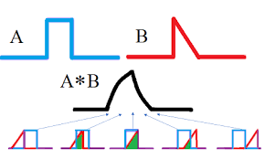
Instantaneous multiplication and addition between two signals

Slide 80
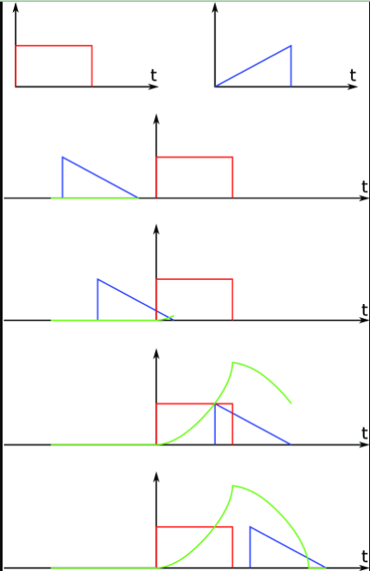
Instantaneous multiplication and addition between two signals
First signal is added with sifted and folded 2nd signal in a periodic manner

Slide 81
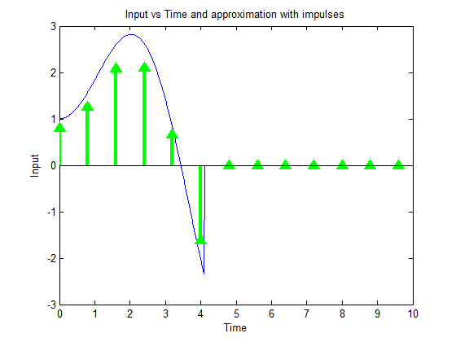

Slide 82
Convolution
Convolution is a mathematical operation used to express the relation between input and output of an LTI system. It relates input, output and impulse response of an LTI system as
y(t)=x(t)∗h(t)
types of convolutions:
Continuous convolution
Discrete convolution

Slide 83
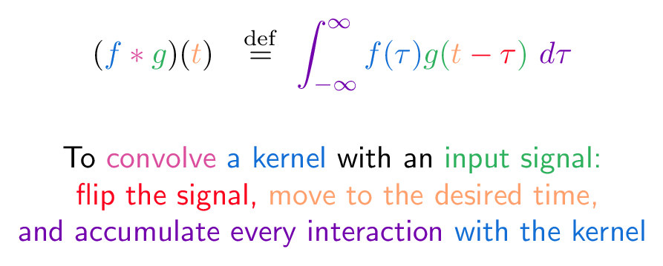
Convolution Equation

Slide 84

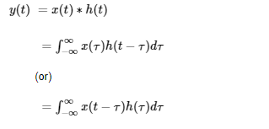

Slide 85

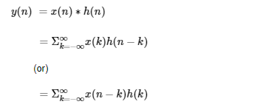

Slide 86
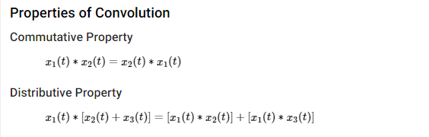

Slide 87
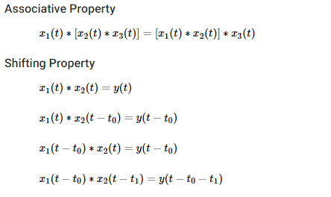

Slide 88
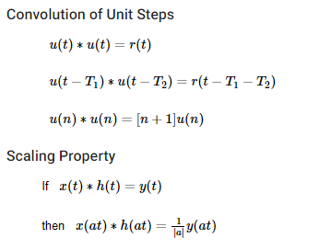

Slide 89
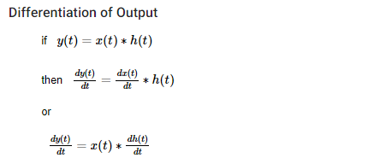

Slide 90
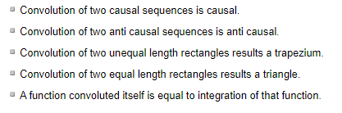
Some useful properties of Convolution

Slide 91
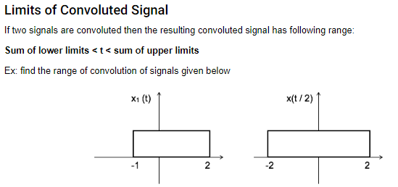

Slide 92
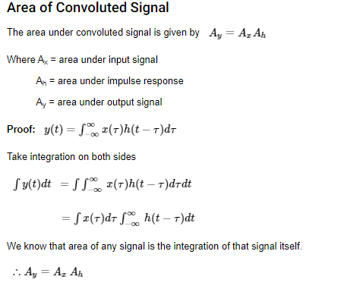

Slide 93
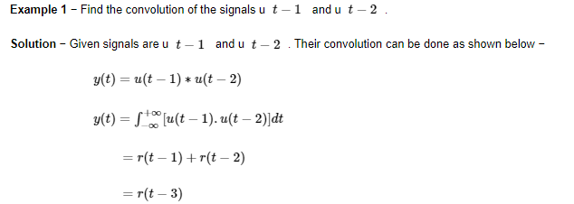

Slide 94
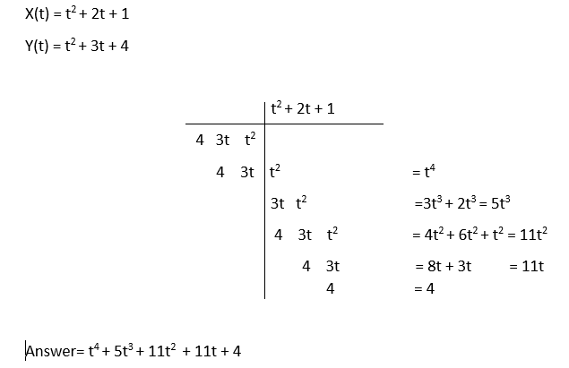
Example no. 2 : Find convolution of the following equations. (CT)

Slide 95



CT Convolution
The (CT) convolution of the functions x and h, denoted x ∗ h, is defined as the function
∫ ∞
x(τ)h(t − τ)dτ.
−∞
x ∗ h(t) =
The convolution result x ∗ h evaluated at the point t is simply a weighted average of the function x, where the weighting is given by h time reversed and shifted by t.
Herein, the asterisk symbol (i.e., “∗”) will always be used to denote convolution, not multiplication.
As we shall see, convolution is used extensively in systems theory.
In particular, convolution has a special significance in the context of LTI systems.

Slide 96







Practical Convolution Computation
To compute the convolution
∫ ∞
x(τ)h(t − τ)dτ,
−∞
x ∗ h(t) =
we proceed as follows:
1
Plot x(τ) and h(t − τ) as a function of τ.
2
Initially, consider an arbitrarily large negative value for t. This will result in
h(t − τ) being shifted very far to the left on the time axis.
3
Write the mathematical expression for x ∗ h(t).
4
Increase t gradually until the expression for x ∗ h(t) changes form. Record
the interval over which the expression for x ∗ h(t) was valid.
5
Repeat steps 3 and 4 until t is an arbitrarily large positive value. This
corresponds to h(t − τ) being shifted very far to the right on the time axis.
6
The results for the various intervals can be combined in order to obtain an
expression for x ∗ h(t) for all t.

Slide 97



Properties of Convolution
The convolution operation is commutative. That is, for any two functions x
and h,
x ∗ h = h ∗ x.
The convolution operation is associative. That is, for any signals x, h₁, and
h₂,
(x ∗ h₁) ∗ h₂ = x ∗ (h₁ ∗ h₂).
The convolution operation is distributive with respect to addition. That is, for any signals x, h₁, and h₂,
x ∗ (h₁ + h₂) = x ∗ h₁ + x ∗ h₂.

Slide 98



Representation of Signals Using Impulses
For any function x,
∫ ∞
x(t) = x(τ)δ(t − τ)dτ = x ∗ δ(t).
−∞
Thus, any function x can be written in terms of an expression involving δ. Moreover, δ is the convolutional identity. That is, for any function x,
x ∗ δ = x.

Slide 99



Periodic Convolution
The convolution of two periodic functions is usually not well defined.
This motivates an alternative notion of convolution for periodic signals known as periodic convolution.
The periodic convolution of the T -periodic functions x and h, denoted
x ⊛ h, is defined as
∫
x ⊛ h(t) =
x(τ)h(t − τ)dτ,
T
¸
where _{T} denotes integration over an interval of length T .
The periodic convolution and (linear) convolution of the T -periodic functions x and h are related as follows:
∞
x ⊛ h(t) = x₀ ∗ h(t) x(t) =
∑
k=−∞
x₀(t − kT )
where
(i.e., x₀(t) equals x(t) over a single period of x and is zero elsewhere).

Slide 100
Section 3.2
Convolution and LTI Systems

Slide 101







Impulse Response
The response h of a system H to the input δ is called the impulse response of the system (i.e., h = H {δ}).
For any LTI system with input x, output y, and impulse response h, the following relationship holds:
y = x ∗ h.
In other words, a LTI system simply computes a convolution. Furthermore, a LTI system is completely characterized by its impulse response.
That is, if the impulse response of a LTI system is known, we can determine the response of the system to any input.
Since the impulse response of a LTI system is an extremely useful quantity, we often want to determine this quantity in a practical setting.
Unfortunately, in practice, the impulse response of a system cannot be determined directly from the definition of the impulse response.

Slide 102



Step Response
dt
Therefore, the impulse response of a system can be determined from its step response by differentiation.
The step response provides a practical means for determining the impulse response of a system.
The response s of a system H to the input u is called the step response of the system (i.e., s = H {u}).
The impulse response h and step response s of a system are related as
ds(t)
h(t) = .

Slide 103


Block Diagram Representation of LTI Systems
Often, it is convenient to represent a (CT) LTI system in block diagram form.
Since such systems are completely characterized by their impulse response, we often label a system with its impulse response.
That is, we represent a system with input x, output y, and impulse response h, as shown below.
x(t) y(t)
h(t)

Slide 104

Interconnection of LTI Systems
The series interconnection of the LTI systems with impulse responses h₁ and h₂ is the LTI system with impulse response h = h₁ ∗ h₂. That is, we have the equivalences shown below.
x(t) y(t)
x(t)
y(t)
h₁(t)
h₂(t)
≡
x(t)
h₁ ∗ h₂ (t)
x(t)
h₁ (t)
h₂(t)
y(t)
≡
h₂(t)
h₁(t)
y(t)
The parallel interconnection of the LTI systems with impulse responses h₁ and h₂ is a LTI system with the impulse response h = h₁ + h₂. That is, we have the equivalence shown below.
x(t) y(t)
h₁(t)
+
≡
x(t)
h₁(t) + h₂(t)
y(t)
h₂(t)

Slide 105
Section 3.3
Properties of LTI Systems

Slide 106

Memory
A LTI system with impulse response h is memoryless if and only if
h(t) = 0 for all t /= 0.
That is, a LTI system is memoryless if and only if its impulse response h is of the form
h(t) = Kδ(t),
where K is a complex constant.
Consequently, every memoryless LTI system with input x and output y is characterized by an equation of the form
y = x ∗ (Kδ) = Kx
(i.e., the system is an ideal amplifier).
For a LTI system, the memoryless constraint is extremely restrictive (as every memoryless LTI system is an ideal amplifier).

Slide 107

Causality
A LTI system with impulse response h is causal if and only if
h(t) = 0 for all t < 0
(i.e., h is a causal signal).
It is due to the above relationship that we call a signal x, satisfying
x(t) = 0 for all t < 0,
a causal signal.

Slide 108



Invertibility
The inverse of a LTI system, if such a system exists, is a LTI system.
Let h and h_{inv} denote the impulse responses of a LTI system and its (LTI) inverse, respectively. Then,
h ∗ h_{inv} = δ.
Consequently, a LTI system with impulse response h is invertible if and only if there exists a function h_{inv} such that
h ∗ h_{inv} = δ.
Except in simple cases, the above condition is often quite difficult to test.

Slide 109
BIBO Stability
A LTI system with impulse response h is BIBO stable if and only if
∫ ∞
∞
_{−∞} |h(t)| dt <
(i.e., h is absolutely integrable).

Slide 110



Eigenfunctions of Systems
An input x to a system H is said to be an eigenfunction of the system H
with the eigenvalue λ if the corresponding output y is of the form
y = λx,
where λ is a complex constant.
In other words, the system H acts as an ideal amplifier for each of its eigenfunctions x, where the amplifier gain is given by the corresponding eigenvalue λ.
Different systems have different eigenfunctions.
Of particular interest are the eigenfunctions of LTI systems.

Slide 111





Eigenfunctions of LTI Systems
As it turns out, every complex exponential is an eigenfunction of all LTI systems.
For a LTI system H with impulse response h,
H {e^{st} } = H(s)e^{st} ,
where s is a complex constant and
∫ ∞
H(s) = h(t)e^{−st} dt.
−∞
That is, e^{st} is an eigenfunction of a LTI system and H(s) is the corresponding eigenvalue.
We refer to H as the system function (or transfer function) of the system H .
From above, we can see that the response of a LTI system to a complex exponential is the same complex exponential multiplied by the complex factor H(s).

Slide 112




Representations of Signals Using Eigenfunctions
Consider a LTI system with input x, output y, and system function H. Suppose that the input x can be expressed as the linear combination of complex exponentials
x(t) = ∑a_{k}e^{skt} ,
k
where the a_{k} and s_{k} are complex constants.
Using the fact that complex exponentials are eigenfunctions of LTI systems, we can conclude
y(t) = ∑a_{k}H(s_{k})e^{skt} .
k
Thus, if an input to a LTI system can be expressed as a linear combination of complex exponentials, the output can also be expressed as a linear combination of the same complex exponentials.
The above formula can be used to determine the output of a LTI system from its input in a way that does not require convolution.

